Slide 1
King County
House Price Predicition

Slide 2
OUR TEAM
Our Team
Himanshu Khandelwal
Pravesh Singhal
Ananya Rakesh
Jitesh More

Slide 3
Objectives
The objective of doing Kc house price prediction is to develop a model that can accurately predict the selling price of houses in King County, Washington.
Helping real estate agents and home sellers to set appropriate prices
Assisting home buyers in making informed decisions about purchasing properties.
Providing valuable insights into the local housing market.

Slide 4
TABLE OF CONTENTS
Tools
1.
Python
2.
Tableau

Slide 5
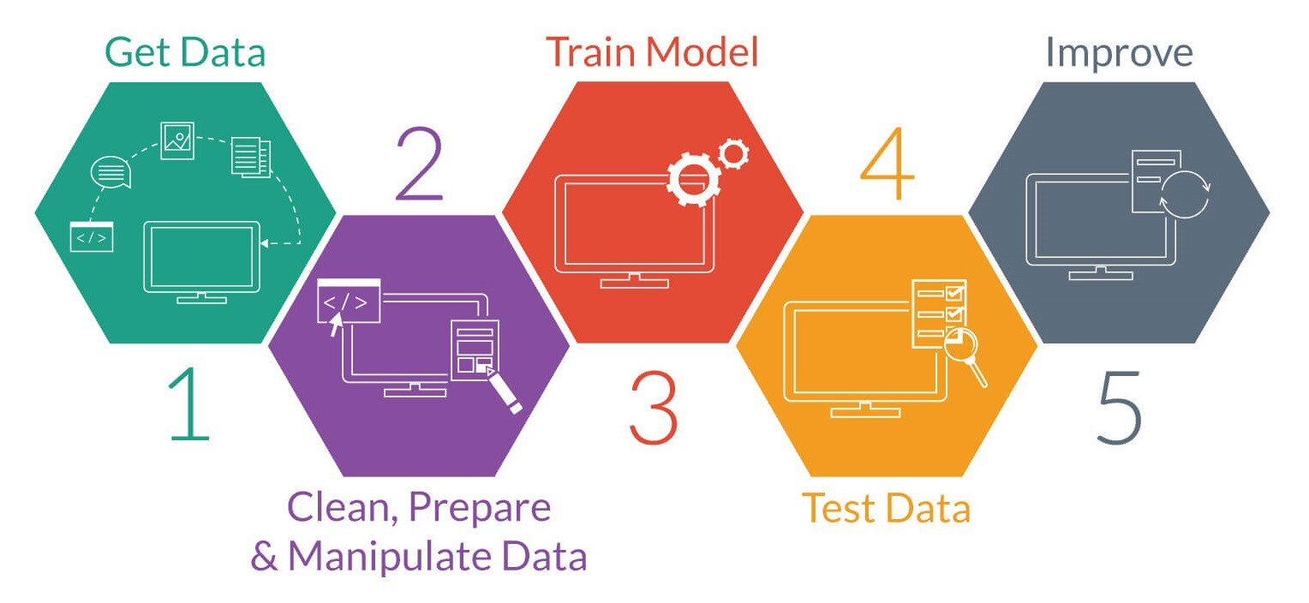
Steps:
MYHOME
REAL ESTATE

Slide 6
Total Houses Listed
1920
1980
2015
Num of Houses 1549
Num of Houses 12575
Num of Houses 21613

Slide 7
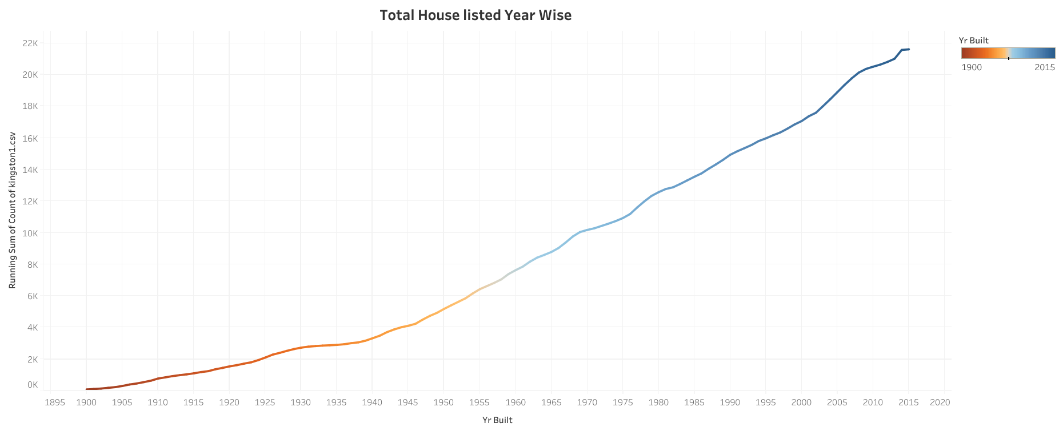
OUR EVOLUTION
Total Houses Listed

Slide 8
WHAT SETS US APART?
Sqft Above
Sqft Basement
Relation b/w

Slide 9
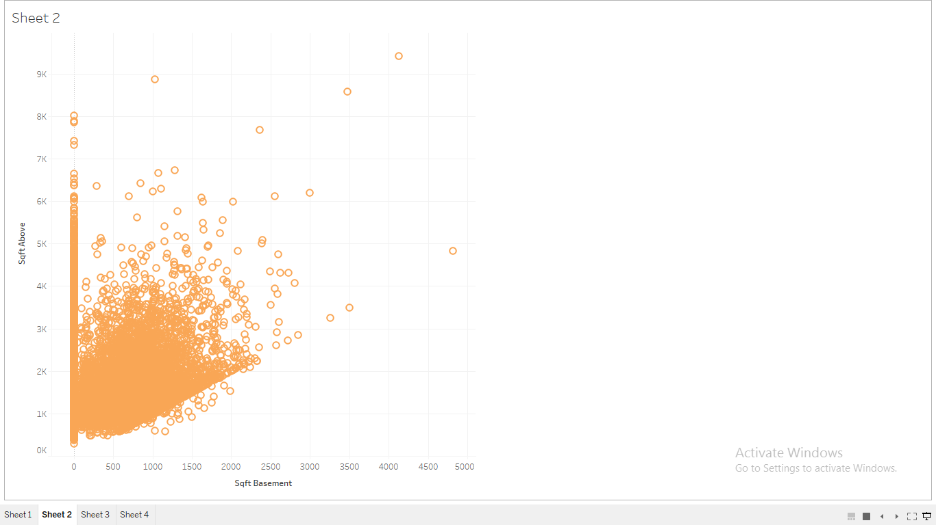
WHAT SETS US APART?
Relation b/w Sqft Above & Sqft Basement

Slide 10
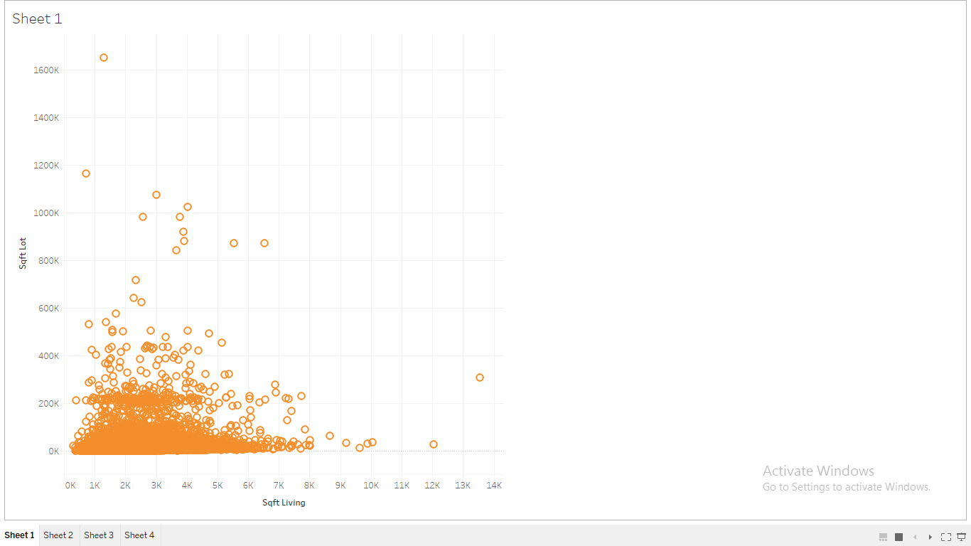
WHAT SETS US APART?
Relation b/w sqft_lot & sqft_living

Slide 11
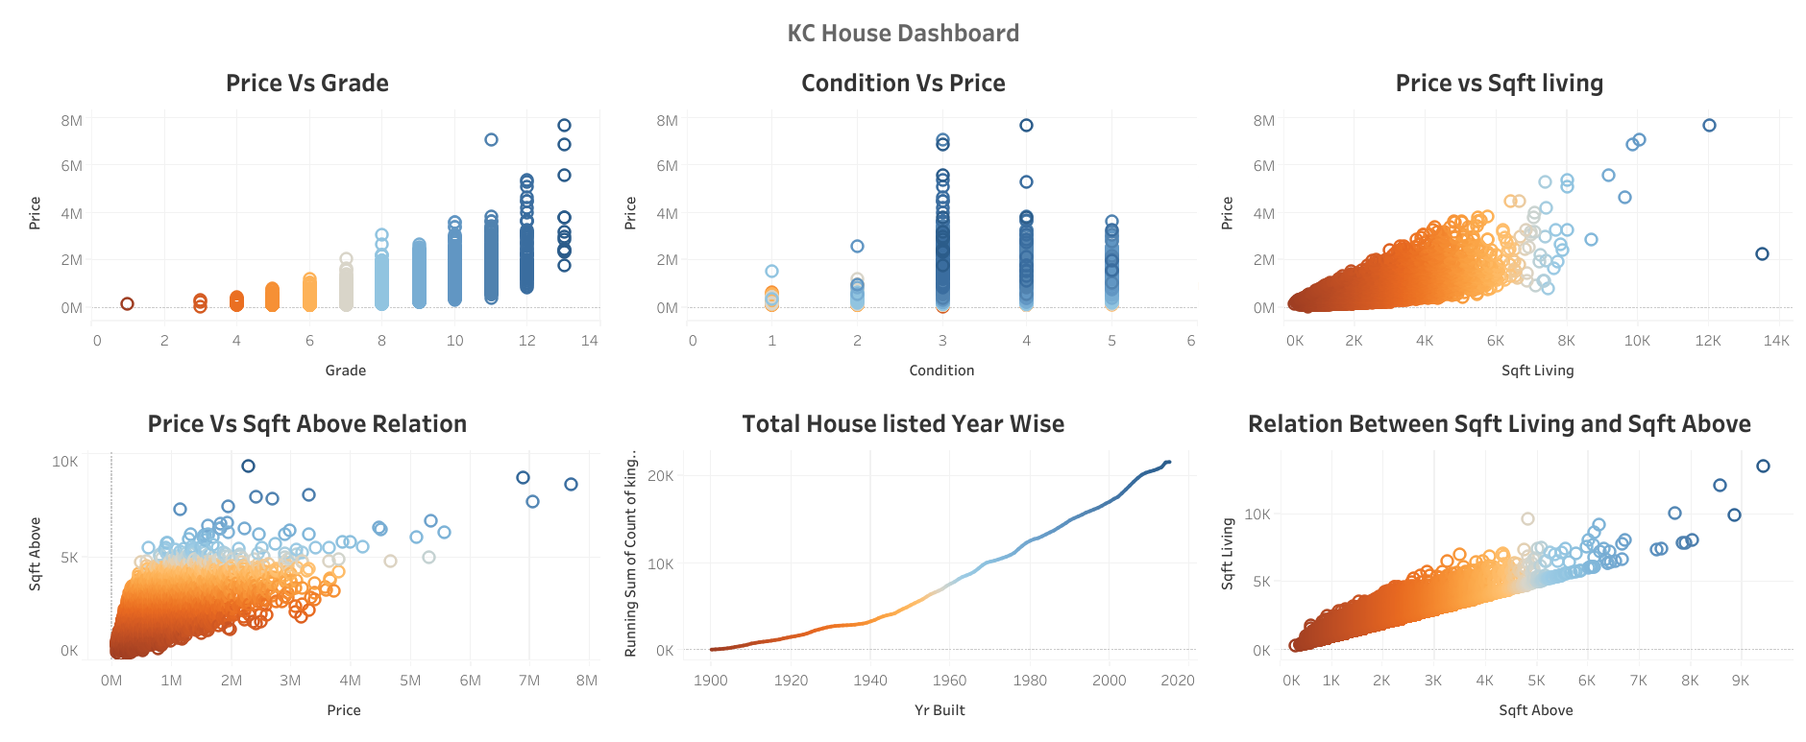
Kc House Data Dashboard:
MYHOME
REAL ESTATE

Slide 12
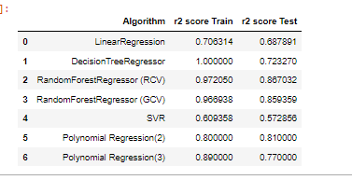
Testing Different Algorithm:
MYHOME
REAL ESTATE

Slide 13
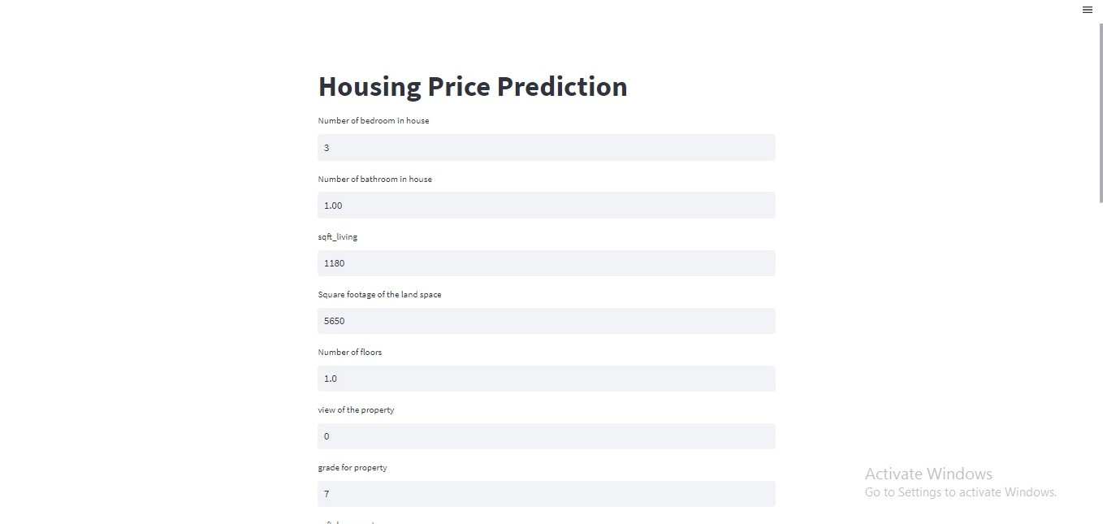
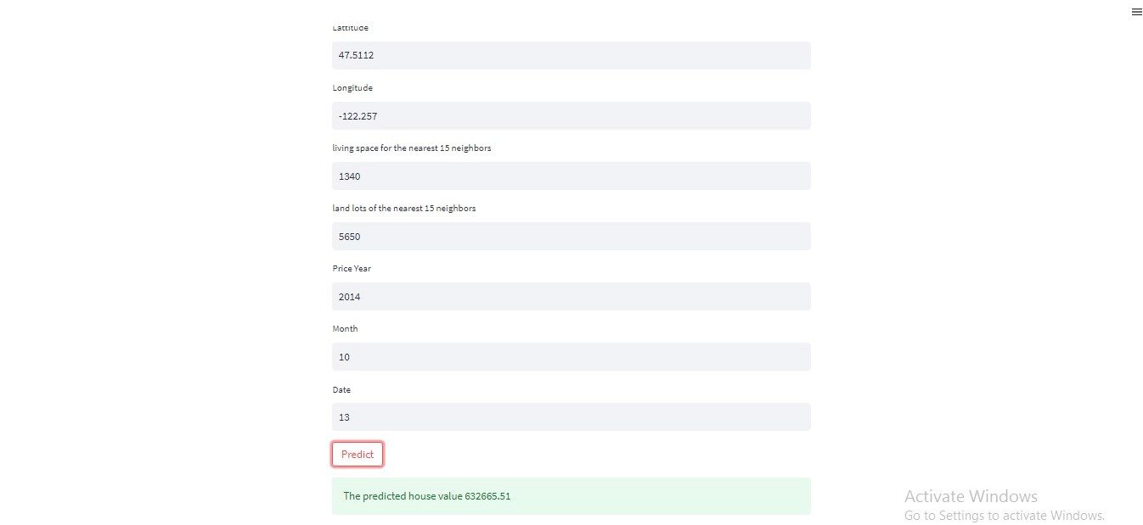
Deploying Model:
MYHOME
REAL ESTATE

Slide 14

Conclusion
This Model can be a valuable tool for real estate professionals, home buyers, and sellers to inform their decision-making and improve their understanding of the market. Some
Points are mentioned:
1. Real estate investments
2. Homeowners insurance
3. Economic forecasting

Slide 15
GUIDING PRINCIPLES
Challenges:
Time Management
Understanding Data
Communication Barriers
Dimensionality
Build Web Page

Slide 16
THANKS
Open For Questions

